Slide 1

COMP-SCI 5590, Special topics (IOT)
Bhavyanth Kondapalli
Chandini Dommaraju
Prathyusha Kondabolu
Samrin Shaik
Sai Krishna Prasad Kammili
Shirisha Baddam
Rakesh Rao Thakkalapelly
Amarnadh Peapalla
Bhavyanth Kondapalli
Chandini Dommaraju
Prathyusha Kondabolu
Samrin Shaik
Sai Krishna Prasad Kammili
Shirisha Baddam
Rakesh Rao Thakkalapelly
Amarnadh Peapalla
Final project

Slide 2
Temperature, HUMIDITY AND AIR QUALITY MONITORING USING ESP32
The project is about monitoring temperature, humidity and air quality in different zones of an area and generating a heat map to provide analysis.
Hardware: Software:
ESP32 Arduino IDE
DHT22 Blynk Platform
MQ135 Proteus
Jumper wires Google Sheets
Bread boards

Slide 3
Source code
Source code comprises of mainly 4 sections
→ Define input pins for sensor input data and read digital/analog data accordingly
→ Define virtual pins on Blynk platform and assign the input pins to virtual pins
→ Generate API token from Blynk and send data to Blynk IOT Platform
→ Send data from zones to Google sheets to generate heat maps
The data sent by the sensors, is then visualized by using widgets in Blynk IOT Platform.

Slide 4
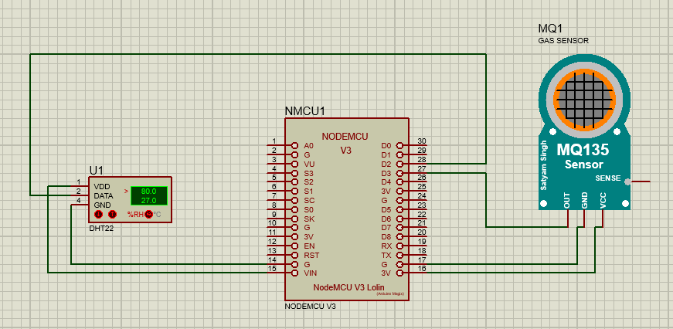
Circuit diagram

Slide 5
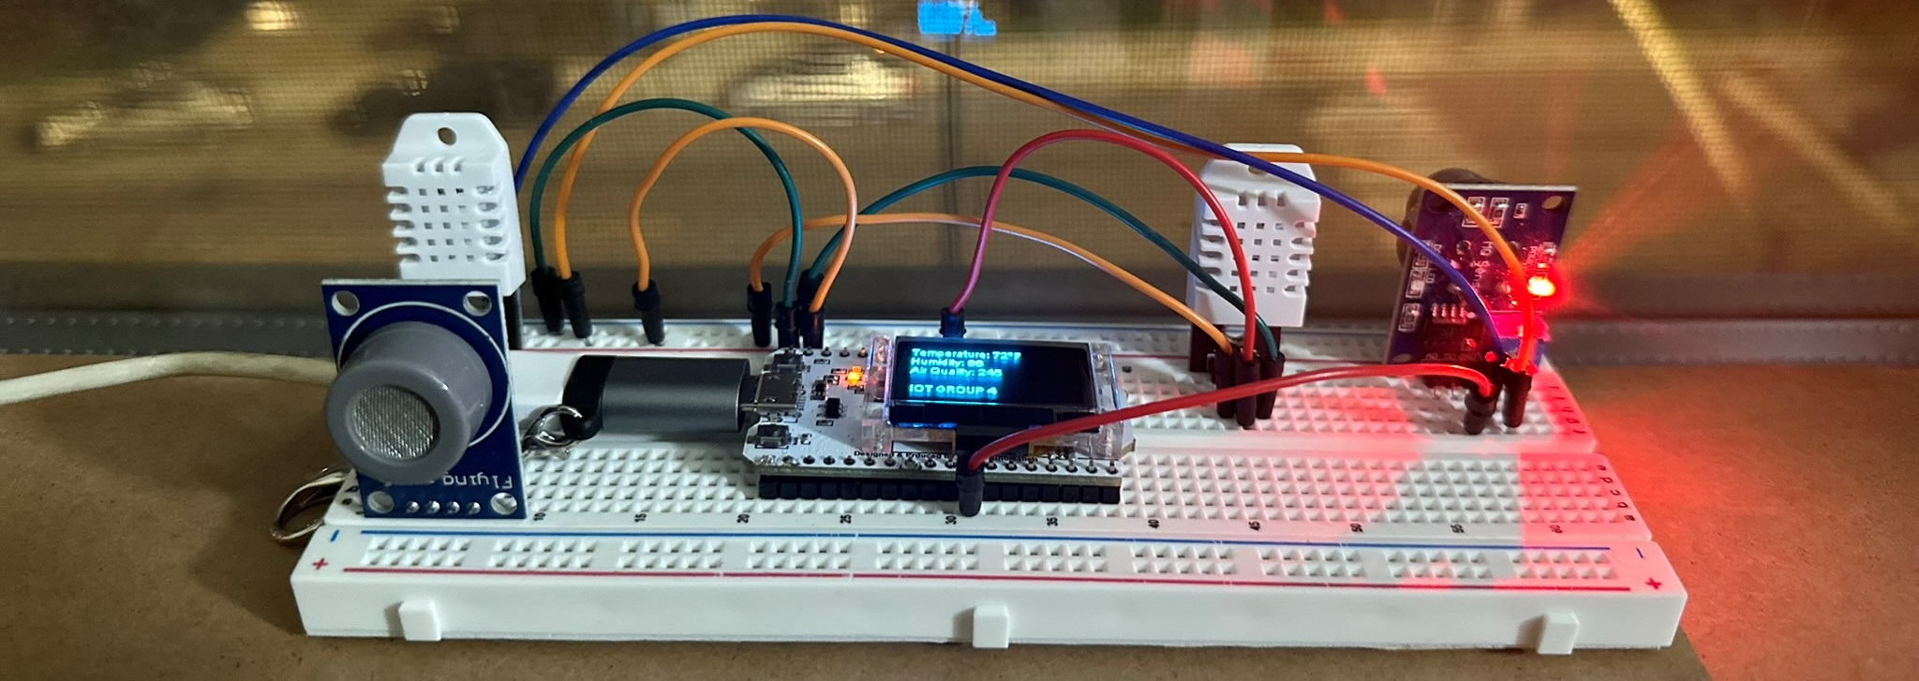
MONITORING ZOnes
Project monitoring is done as per zones, where temperature, humidity and air quality is recorded. 3 ESP32 modules are running for 5 days and transmitting data for every 30 seconds time frame.
ZONE 1:

Slide 6
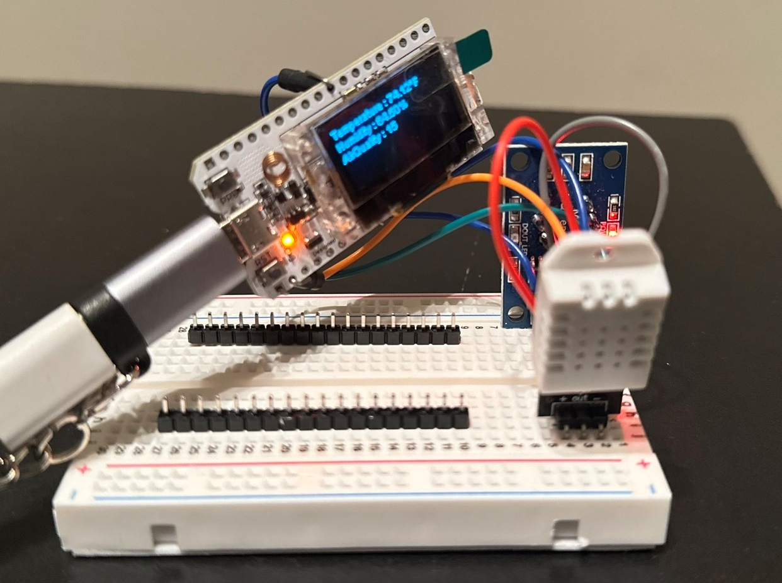
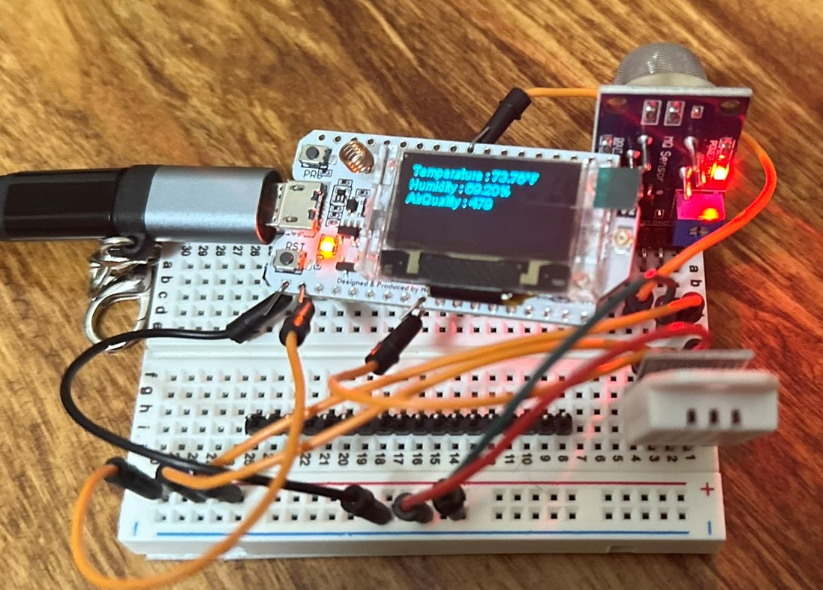
ZONES
Zone 2:
Zone 3:

Slide 7
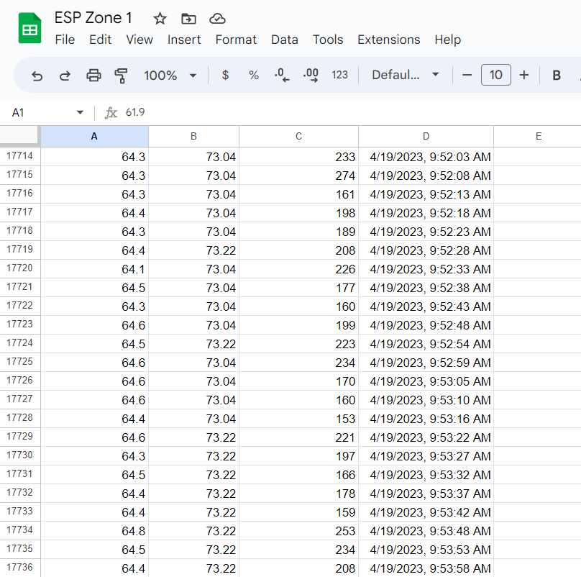
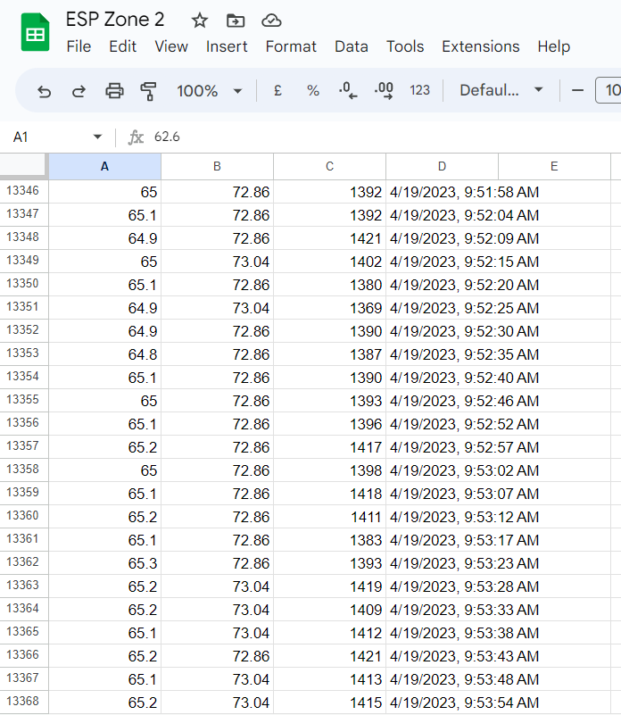
Temperature, Humidity and AIR Quality data
Zone 1 Data:
Zone 2 Data:

Slide 8
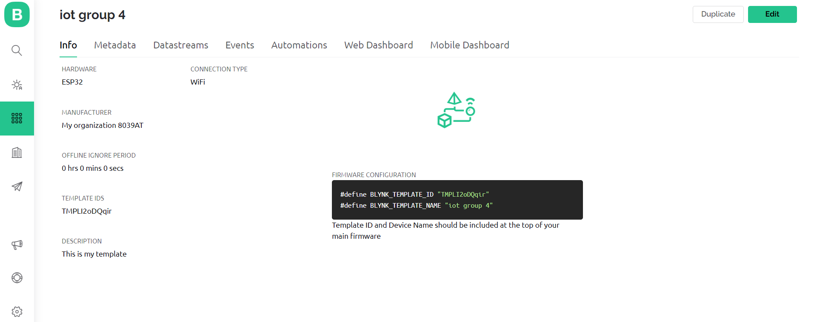
BLYNK IOT PLATFORM
Blynk platform is used to fully automate and monitor the sensor data over the cloud. ESP32 connects and shares data to Blynk cloud via API tokens and unique project template IDs. Data from the sensors is read via virtual pins from the dashboard.

Slide 9
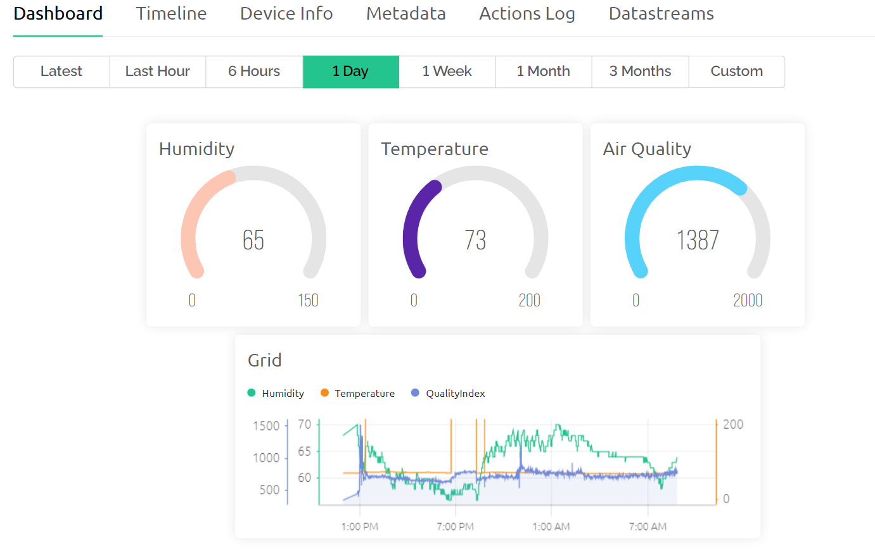
WEB dashboard
Widgets are added to record the temperature, humidity and Air quality indexes.
Visual representations are made based on the sensor data.
HeatMap will be generated.

Slide 10

Generating heat maps
Data from 3 zones is collected to a new sheet with temperature, humidity and air quality data segregated as per date.
Conditional formatting is enabled on cells and colors are assigned with minimum and maximum value indicated.
Produced output is the heatmap for temperature, humidity data.
Data is shrinked to 1000 rows per day for better visualization purposes.

Slide 11
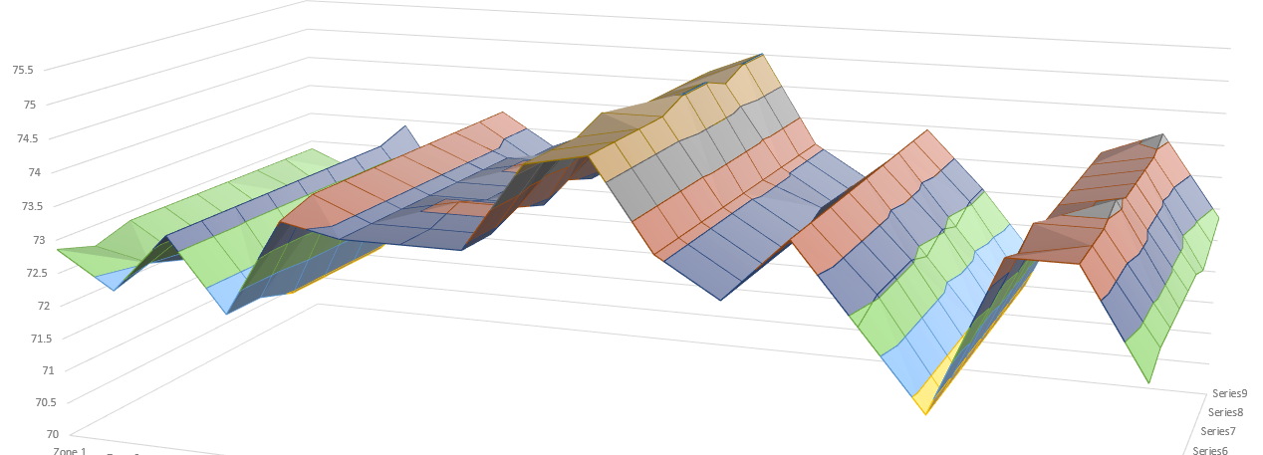
Air Qulity heatmap

Slide 12
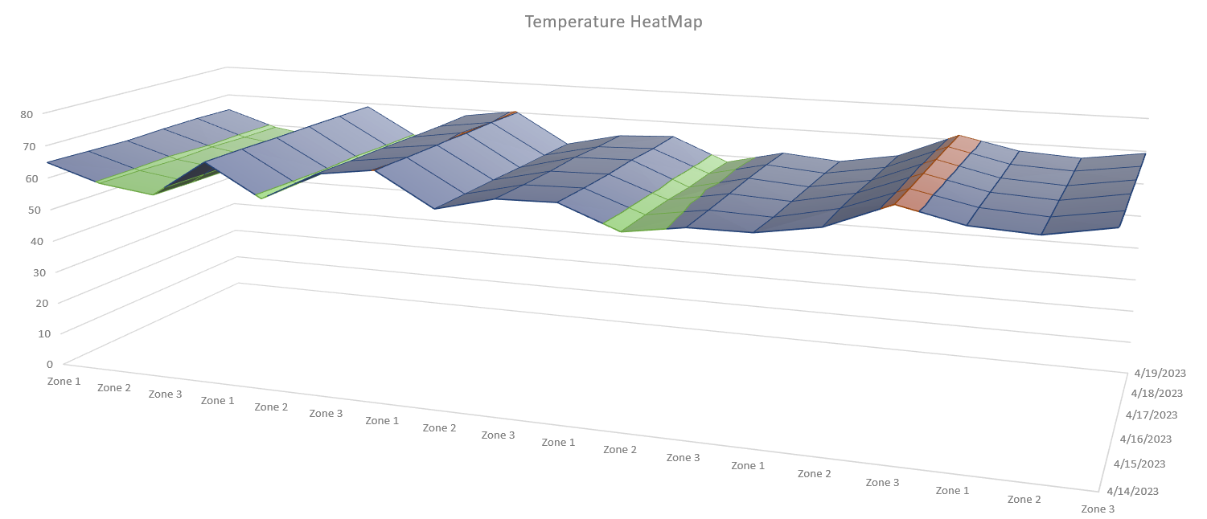
TEmperature HEATMAP

Slide 13
Reference values
MQ 135
0-50 – Good
51-100 – Moderate
101-150 – Unhealthy for sensitive groups
151-200 – Unhealthy
DHT 22
Temperature: -40°C ~ 80°C
Humidity: 0%RH ~ 99.9%RH

Slide 14


LINKS
Source Code Link: https://github.com/Bhavyanth/Temperature-Airquality
YouTube Video Link: https://youtu.be/ZW9105k9tzg
Blynk Dashboard: https://blynk.cloud/dashboard/100154/global/filter/658901/organization/100154/devices/380831/dashboard

Slide 15
References
https://www.waveshare.com/wiki/DHT22_Temperature-Humidity_Sensor
https://how2electronics.com/iot-air-quality-index-monitoring-esp8266/
https://docs.blynk.io/en/?_ga=2.157002495.556598436.1651813551-753677164.1651678057
https://proteustoolkit.org/

Slide 16
THANK YOU

